Slide 1
Intro to Docker
With RJ

Slide 2
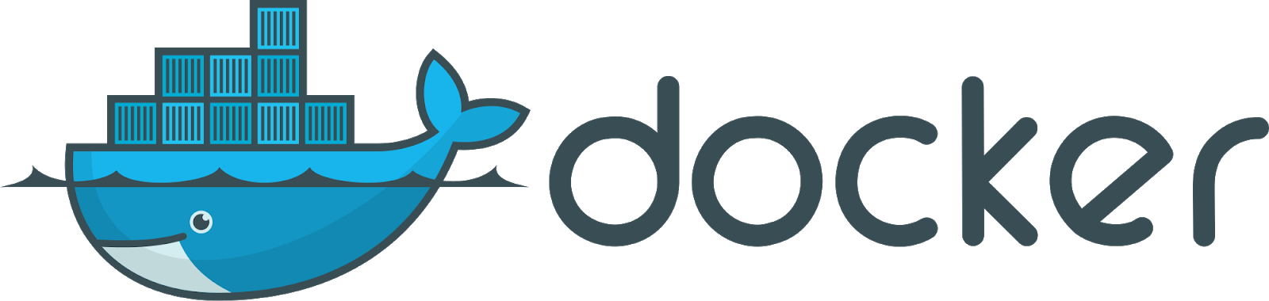
What is docker?
Docker is an open platform for developing, shipping, and running applications. Docker enables you to separate your applications from your infrastructure so you can deliver software quickly. With Docker, you can manage your infrastructure in the same ways you manage your applications. By taking advantage of Docker’s methodologies for shipping, testing, and deploying code quickly, you can significantly reduce the delay between writing code and running it in production.
Docker in 12 Minutes: https://www.youtube.com/watch?v=YFl2mCHdv24

Slide 3
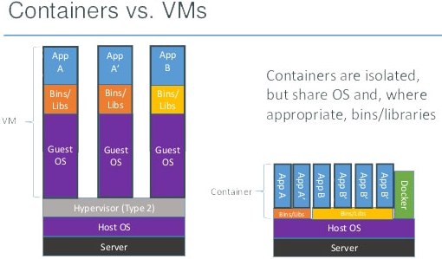
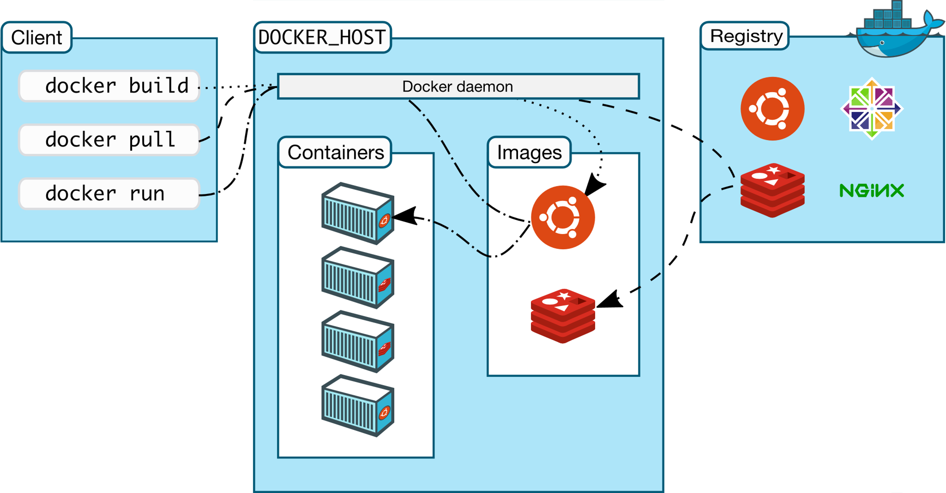
What is docker?
Docker is the missing link in development*
Docker is an open source tool for deploying lightweight virtual machines which include everything needed to run a given application, known as containers.
For more information: DockerCon presentations on the topic, Ryan Herman did a talk last year as well (https://www.youtube.com/channel/UC02MSUwSBNSABjXaO2c60BQ), and the official website (docker.com)

Slide 4
Why you should want to learn Docker
Docker has quickly become the standard for packaging applications
Companies and open source projects want you to know it
Helps your projects become easier to clone and deploy
No matter how good your documentation is, everyone’s machine is different; prevent hand holding through explicitly depicting how your application will be setup and ran
Allows you to treat your infrastructure as an extension of your code, no need to provide instructions on how to setup databases or any other applications vital to your project
Helps make your project easier to test, and more robust as a result
Before pushing changes, you can run a container which copies the current iteration of your project and then runs tests to assure your code is ready to be pushed

Slide 5
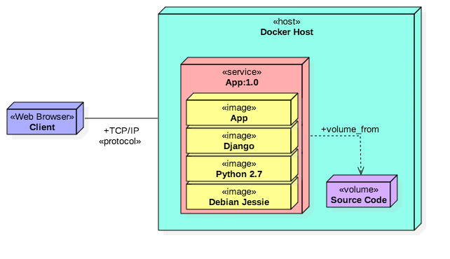
Why use docker?
Easily create databases, web drivers, webservers, etc.
Create environments for your code to run predictably, regardless of the OS used
Compose projects consisting of many pieces (ex. webserver, an API, and a database) which can be transported in a simple and reliable manner and then deployed with little effort

Slide 6
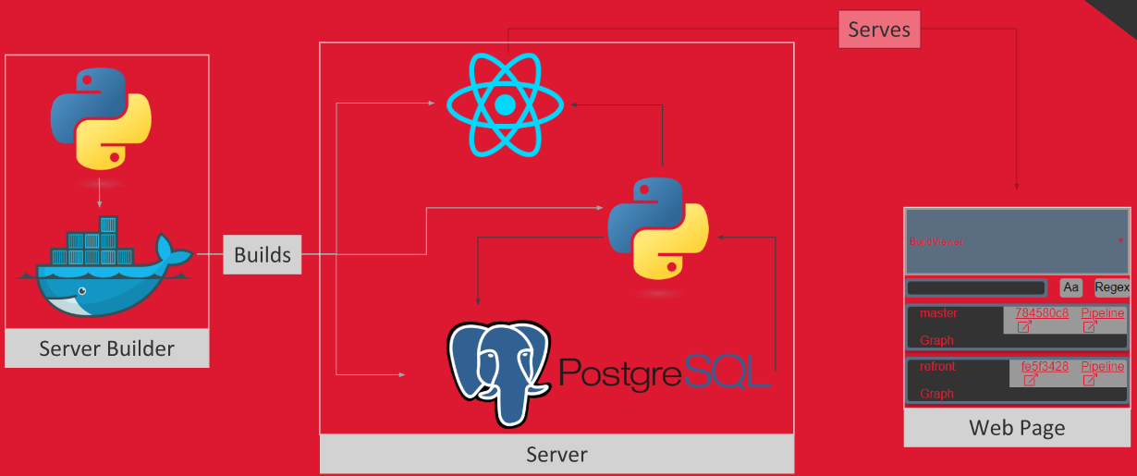
Why use docker?
Easily create databases, web drivers, webservers, etc.
Create environments for your code to run predictably, regardless of the operating system being used
Compose projects consisting of many pieces (webserver, an API, and a database) which can be transported in a simple and reliable manner and then deployed with little effort

Slide 7
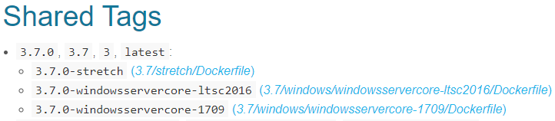


Docker IMages
A Docker image is an ordered collection of root filesystem changes and commands used within a container when the image is built into a container
Images are read-only
Images are stored locally, or can be stored remotely via a registry (hub.docker.com)
Images are built using Dockerfiles
Existing images can be used to build other images, using Dockerfiles
This One

Slide 8
Docker Containers
A container is an active (or inactive if exited) stateful instantiation of an image
Docker containers are essentially lightweight virtual machines
Containers will run exactly the same every time, given that execution variables (network data, general input to the container) are the same
Containers are “running” images
This One

Slide 9
Docker cli
The Docker CLI allows us to communicate with the Docker daemon (roughly houses the core functionality of Docker) in a streamlined manner
Important commands (execute “docker --help | grep {command}”):
docker run {image name} – run image (creates container)
docker ps – list all images, shows their running state (running, stopped, etc)
docker stop {container hash/ container name} – stops a running container
docker start {container hash/ container name} – starts a stopped container
docker rm {container hash/ container name} – removes a stopped container
docker pull {image name} – pulls a remote image for local use
docker build {path to dockerfile} – builds an image from a dockerfile
This One

Slide 10
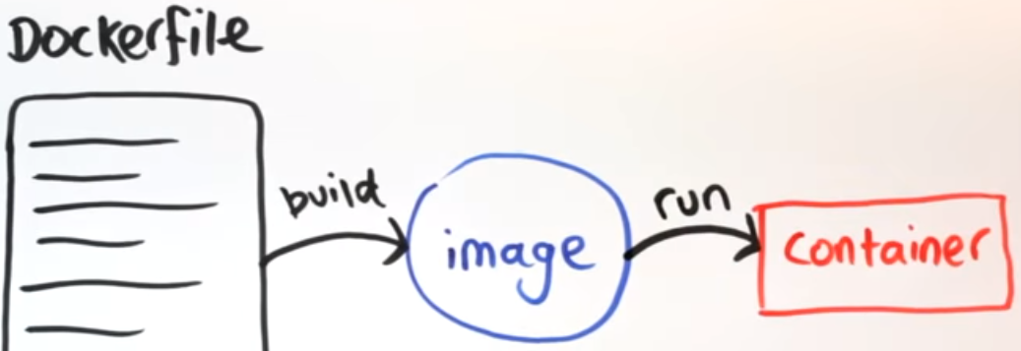
How images and containers relate

Slide 11















Docker registry
Like Github for Docker images, you can store your images there
The Docker registry (hub.docker.com) stores a large collection of docker images which you can build atop or run as a container

Slide 12
DockerFiles
Dockerfiles allow you to control how an image is constructed, which you can then run as a container
You can built off of existing images, provided you have access to them
Allows you to craft custom environments to fit your needs
You can build an image from a Dockerfile, which you can then run or push to a registry
Both Of These

Slide 13
DockerFiles
Dockerfile Instructions https://github.com/wsargent/docker-cheat-sheet#dockerfile
Each line in a Dockerfile is a layer, layers are cached between each time an image is built, the cached layer will be used provided two conditions hold true:
The current layer (line) has not changed
The previous layer (line) has not changed
FROM - Sets the Base Image for subsequent instructions.
RUN - execute any commands in a new layer on top of the current image
CMD - provide defaults for an executing container
EXPOSE - informs Docker that the container listens on the specified network ports at runtime.
NOTE: does not actually make ports accessible
ENV - sets environment variable
ADD - copies new files, directories or remote file to container. Invalidates caches. Avoid ADD and use COPY instead
ENTRYPOINT - configures a container that will run as an executable
Both Of These

Slide 14
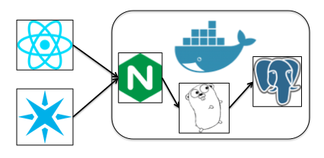
Docker compose
Allows you to compose multiple Docker containers into a unified project
Similar to how we built single containers and ran them, we can build containers within a Docker-Compose project by running “docker-compose build”
The project (consisting of multiple Docker containers relying on one another) can then be ran by executing “docker-compose up”
Conversely, the containers for the project can be stopped by running “docker-compose down”

